Slide 1

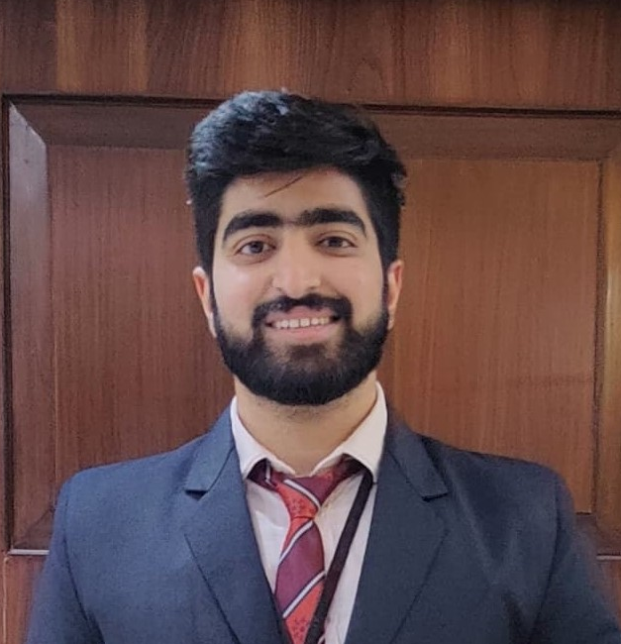

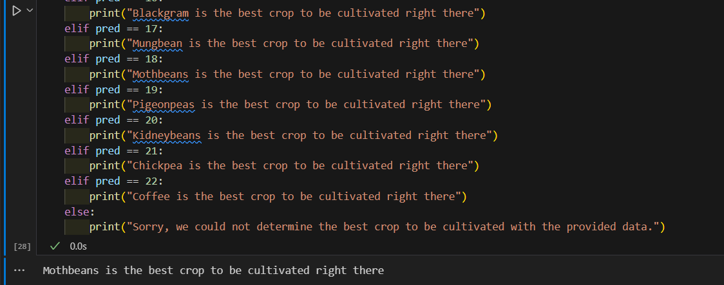
Water Treatment and Crop Recommendation System using AI
Program Feedback
Project Short Summary
It was a very nice experience attending this internship and very thankful to the faculties (Aswini sir, Khushboo Ma’am, Aditya sir) for making this internship happen.
The Water Treatment and Crop Recommendation System using AI leverages advanced algorithms to optimize water usage and enhance crop productivity. The implementation has shown improved resource efficiency and higher agricultural yields, promoting sustainable farming practices. Future developments aim to integrate IoT devices, expand scalability, and incorporate advanced AI models for more precise and dynamic recommendations.
Final Project Outcome Screenshot
AKASH KAPOOR
akashkapoor976@gmail.com
CHANDIGARH UNIVERSITY
#skillsbuild

